Slide 1
WIFI SSID:Spark+AISummit | Password: UnifiedDataAnalytics

Slide 2



The Parquet Format and Performance Optimization Opportunities
Boudewijn Braams
Software Engineer - Databricks
#UnifiedDataAnalytics #SparkAISummit

Slide 3


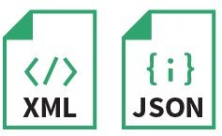

Data processing and analytics
Data processing/querying engine
New insights
Data sources
Transformed data (ETL)
….

Slide 4
Overview
Data storage models
The Parquet format
Optimization opportunities

Slide 5
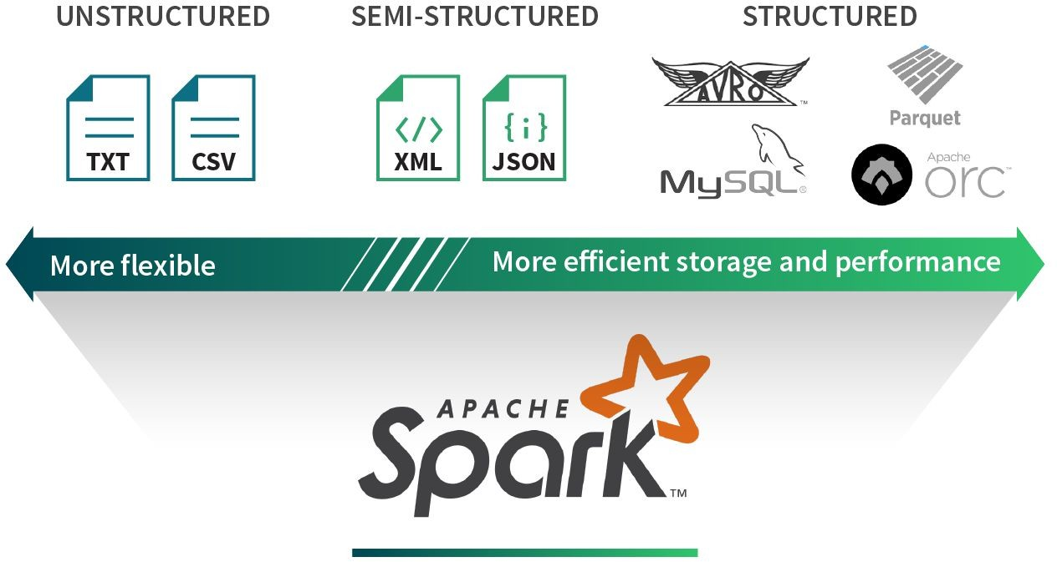

Data sources and formats

Slide 6
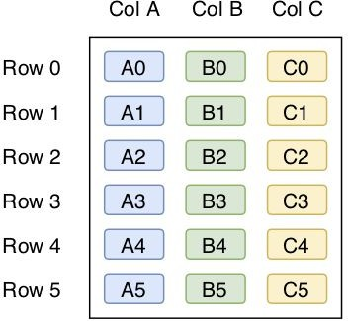
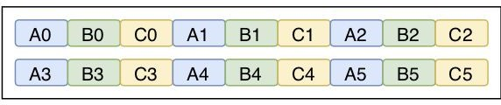
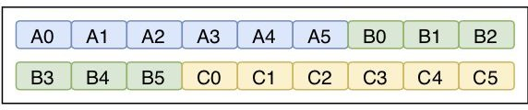
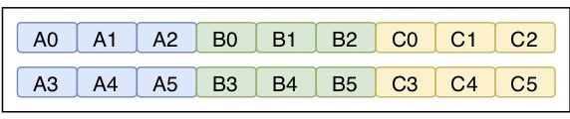
Physical storage layout models
Logical
Physical
Row-wise
Columnar
Hybrid

Slide 7
Different workloads
OLTP
Online transaction processing
Lots of small operations involving whole rows
OLAP
Online analytical processing
Few large operations involving subset of all columns
Assumption: I/O is expensive (memory, disk, network..)

Slide 8
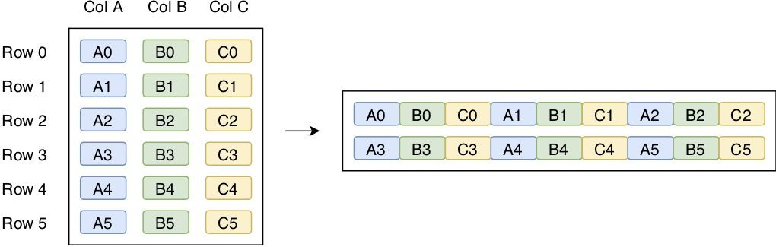

Row-wise
Horizontal partitioning
OLTP ✓, OLAP ✖

Slide 9
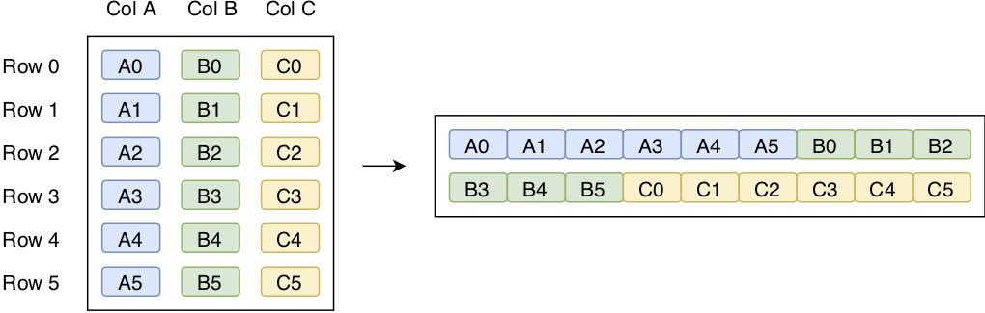
Columnar
Vertical partitioning
OLTP ✖, OLAP ✓
Free projection pushdown
Compression opportunities

Slide 10
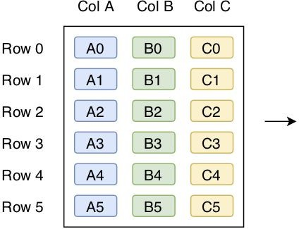
Row-wise vs Columnar
?

Slide 11
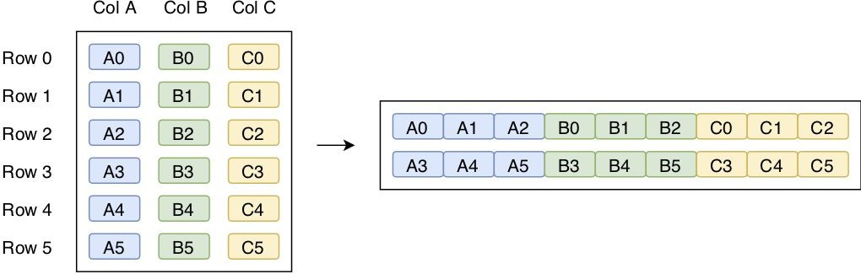
Hybrid
Horizontal & vertical partitioning
Used by Parquet & ORC
Best of both worlds

Slide 12

Apache Parquet
Initial effort by Twitter & Cloudera
Open source storage format
Hybrid storage model (PAX)
Widely used in Spark/Hadoop ecosystem
One of the primary formats used by Databricks customers

Slide 13
Parquet: files
On disk usually not a single file
Logical file is defined by a root directory
Root dir contains one or multiple files
./example_parquet_file/
./example_parquet_file/part-00000-87439b68-7536-44a2-9eaa-1b40a236163d-c000.snappy.parquet
./example_parquet_file/part-00001-ae3c183b-d89d-4005-a3c0-c7df9a8e1f94-c000.snappy.parquet
or contains sub-directory structure with files in leaf directories
./example_parquet_file/
./example_parquet_file/country=Netherlands/
./example_parquet_file/country=Netherlands/part-00000-...-475b15e2874d.c000.snappy.parquet
./example_parquet_file/country=Netherlands/part-00001-...-c7df9a8e1f94.c000.snappy.parquet

Slide 14
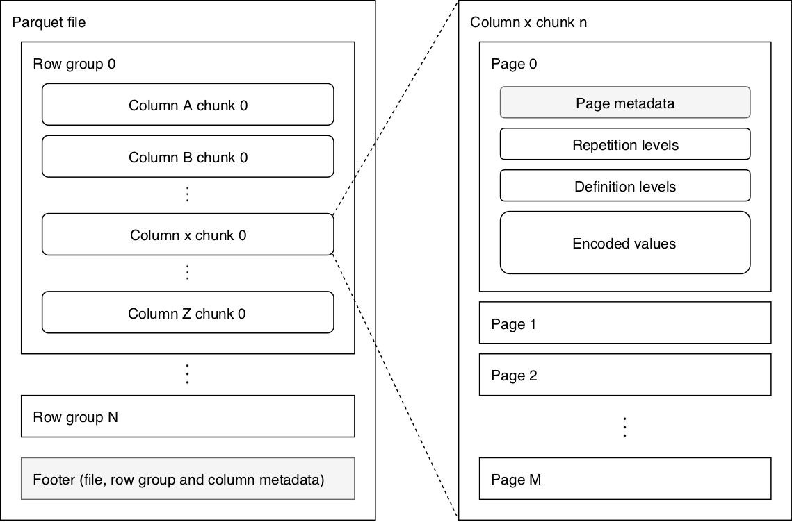
Parquet: data organization
Data organization
Row-groups (default 128MB)
Column chunks
Pages (default 1MB)
Metadata
Min
Max
Count
Rep/def levels
Encoded values

Slide 15
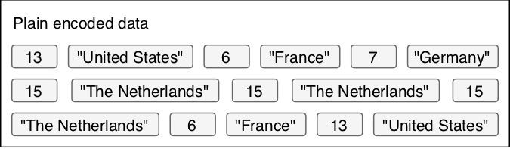
Parquet: encoding schemes
PLAIN
Fixed-width: back-to-back
Non fixed-width: length prefixed
RLE_DICTIONARY
Run-length encoding + bit-packing + dictionary compression
Assumes duplicate and repeated values

Slide 16
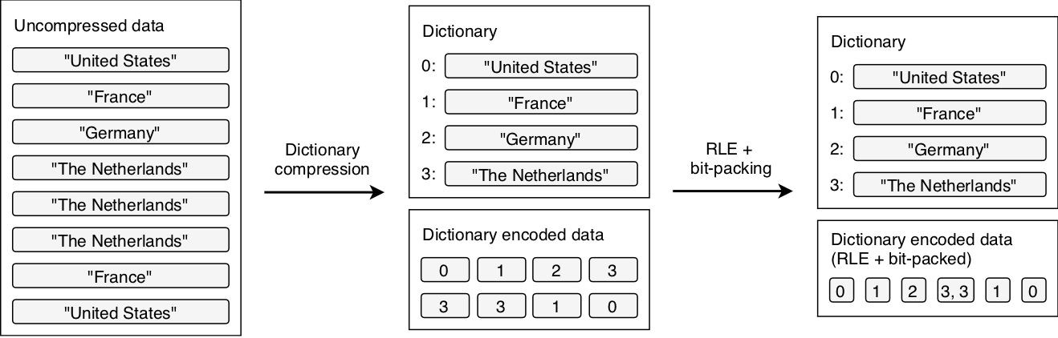
Parquet: encoding schemes
RLE_DICTIONARY

Slide 17
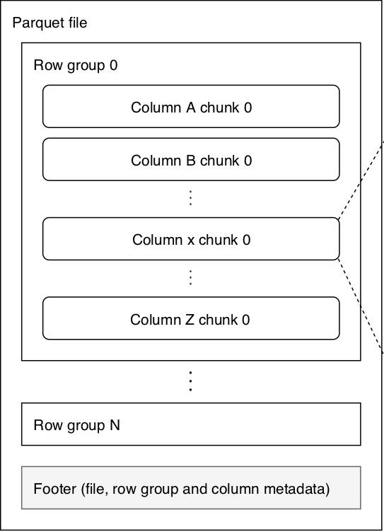
Optimization: dictionary encoding
Smaller files means less I/O
Note: single dictionary per column chunk, size limit
Dictionary too big?
Automatic fallback to PLAIN...

Slide 18
Optimization: dictionary encoding
Increase max dictionary size
parquet.dictionary.page.size
Decrease row-group size
parquet.block.size

Slide 19
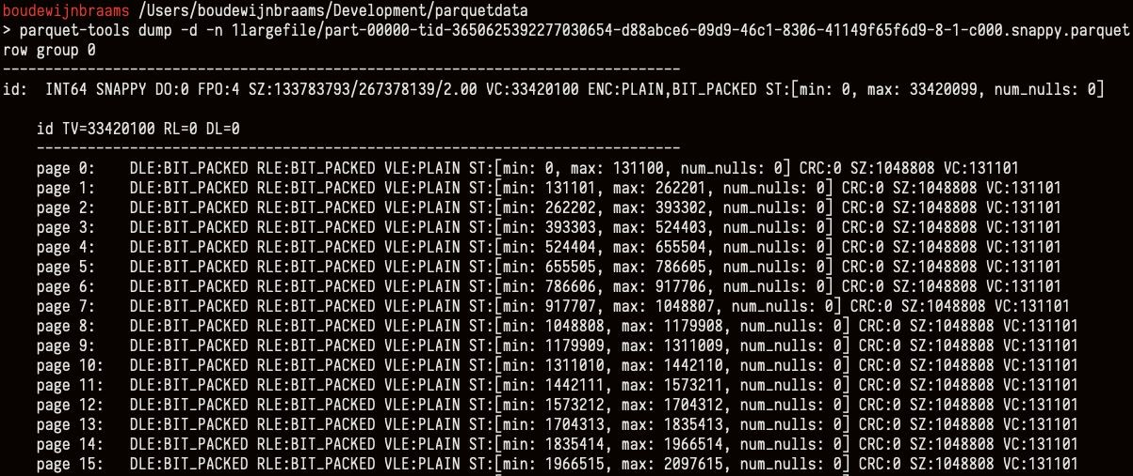
Optimization: dictionary encoding
Inspect Parquet files using parquet-tools

Slide 20
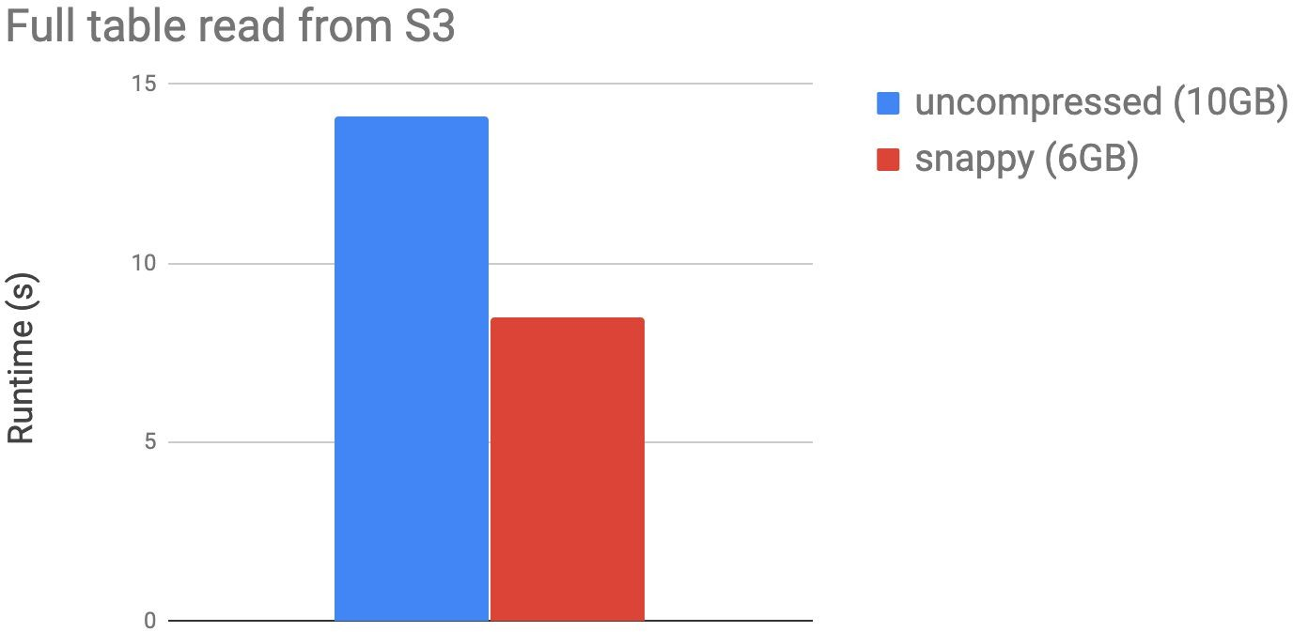
Optimization: page compression
Compression of entire pages
Compression schemes (snappy, gzip, lzo…)
spark.sql.parquet.compression.codec
Decompression speed vs I/O savings trade-off

Slide 21
Optimization: predicate pushdown
SELECT * FROM table WHERE x > 5
Row-group | 0: | x: | [min: | 0, | max: | 9]
Row-group | 1: | x: | [min: | 3, | max: | 7]
Row-group | 2: | x: | [min: | 1, | max: | 4]
…
Leverage min/max statistics
spark.sql.parquet.filterPushdown

Slide 22
Optimization: predicate pushdown
Doesn’t work well on unsorted data
Large value range within row-group, low min, high max
What to do? Pre-sort data on predicate columns
Use typed predicates
Match predicate and column type, don’t rely on casting/conversions
Example: use actual longs in predicate instead of ints for long columns

Slide 23
Optimization: predicate pushdown
SELECT * FROM table WHERE x = 5
Row-group | 0: | x: | [min: | 0, | max: | 9]
Row-group | 1: | x: | [min: | 3, | max: | 7]
Row-group | 2: | x: | [min: | 1, | max: | 4]
…
Dictionary filtering!
parquet.filter.dictionary.enabled

Slide 24
Optimization: partitioning
Embed predicates in directory structure
df.write.partitionBy(“date”).parquet(...)
./example_parquet_file/date=2019-10-15/...
./example_parquet_file/date=2019-10-16/...
./example_parquet_file/date=2019-10-17/part-00000-...-475b15e2874d.c000.snappy.parquet
…

Slide 25
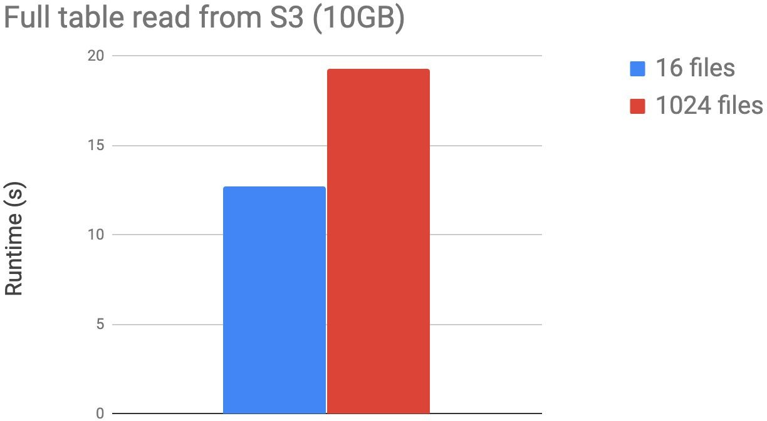
Optimization: avoid many small files
For every file
Set up internal data structures
Instantiate reader objects
Fetch file
Parse Parquet metadata

Slide 26
Optimization: avoid many small files
Manual compaction
df.repartition(numPartitions).write.parquet(...)
or
df.coalesce(numPartitions).write.parquet(...)
Watch out for incremental workload output!

Slide 27
Optimization: avoid few huge files
Also avoid having huge files!
SELECT count(*) on 250GB dataset
250 partitions (~1GB each)
5 mins
1 huge partition (250GB)
1 hour
Footer processing not optimized for speed...

Slide 28

Optimization: avoid many small files
Manual repartitioning
Can we automate this optimization?
What about concurrent access?
We need isolation of operations (i.e. ACID transactions)
Is there anything for Spark and Parquet that we can use?

Slide 29
Optimization: Delta Lake
Open-source storage layer on top of Parquet in Spark
ACID transactions
Time travel (versioning via WAL)
...
Automated repartitioning (Databricks)
(Auto-) OPTIMIZE
Additional file-level skipping stats
Metadata stored in Parquet format, scalable
Z-ORDER clustering

Slide 30
Conclusion
Reduce I/O
Reduce size
Use page compression, accommodate for RLE_DICTIONARY
Avoid reading irrelevant data
Row-group skipping: min/max & dictionary filtering
Leverage Parquet partitioning
Reduce overhead
Avoid having many small files (or a few huge)
Delta Lake
(Auto-) OPTIMIZE, additional skipping, Z-ORDER

Slide 31


Thank you

Slide 32


DON’T FORGET TO RATE AND REVIEW THE SESSIONS
SEARCH SPARK + AI SUMMIT

